Slide 2
Storage & Databases
APP Course
Notes:
Ask some questions
How many have used a databse?
How many have used SQL Server?

Slide 3
Agenda
Intro to databases
Data modelling
Structured Query language (SQL)
Performance
Workshop

Slide 4
Intro: Why do we need databases?
«Databases are essential for organizing, managing, securing, and efficiently retrieving data, making them a fundamental component of nearly every software system and data-driven organization. They enable data-driven decision-making, support business processes, and ensure data is available, reliable, and secure”
“Databases are fundamental to modern computing environments, supporting a wide range of applications from simple websites to complex analytical systems, ensuring that data is organized, secure, accessible, and useful.”
Notes:
The 1960s saw the emergence of the first navigational database systems. These systems, such as IBM's Information Management System (IMS) and Charles Bachman's Integrated Data Store (IDS), were hierarchical and network databases

Slide 5
Intro: Types of databases
process
Relation databases (RDBMS)
Structured data
Tables, rows, columns
Relationships between tables
ACID (Atomicity, Consistency, Isolation, Durability) properties, which ensure that database transactions are reliable, consistent, and maintain data integrity
Supports Structured Query Language (SQL)
Non-relation (NoSQL) databases
Unstructred, semi-structured & structured data
Document stores (json/bson)
Key-value stores (key-value pairs)
Object stores (files and media)
Varying degree of support for transactions
No standard query language, often APIs or SQL-like query language
Notes:
Edgar F. Codd, an English computer scientist working at IBM, in a seminal 1970 paper titled "A Relational Model of Data for Large Shared Data Banks

Slide 6
Intro: Relation databases vs non-relation (NoSQL) databases
GitHub Actions
Choose a relation database when:
Data structure is well defined
ACID is a requirement
Need to run complex queries
Extra level of security
Small to medium sized database
Legacy stystems
Choose a NoSQL database when:
Semi-structured or unstructured data
Massive amounts of data
High availability & low latency
Simplfy development complexity (less need for ORM)
More cost-effective at large scale
Notes:
ORM – Object Rational Mapping: Entity Framework , Dapper, Hsibernate, Django

Slide 7
Intro: Most used databases
Pull requests
Relation databases
Microsoft SQL Server
Oracle Databases
SQLite
MySQL
PostgreSQL
No-SQL databases
MongoDB (Document database)
Amazon DynamoDB
Redis (Key-value store)

Slide 8
Data modelling
GitHub Actions
Several key principles should be followed to ensure the database is structured efficiently, scalable, and capable of supporting the applications that will interact with it:
Normalization – Minimize redundancy and dependency (1NF, 2NF, 3NF) - Theory
Data integrity
Entity (primary key, uniquely identifies a row)
Reference (foreign key ensures that referenced rows exists)
Domain (the columns have correct data type, format and valid values)
Keys - Primary , foreign, unique, (composite)
Performance – indexes
Entity-Relationship (ER) diagrams

Slide 9

Entity-Relationship (ER) diagrams
Environments
“ER diagrams are used in database design and systems analysis because they provide a graphical way to model data structures and their relationships in a clear and systematic manner”
Database design
Visual Representation
Communication tool
Documentation
Notes:
You may have heard about sequence diagrams, flow chars and other diagrams
Any of you ever heard of/used ER-diagrams?
Is it really as simple as the example ER diagram shows?
Need to know all artist that have performed a certain song

Slide 10
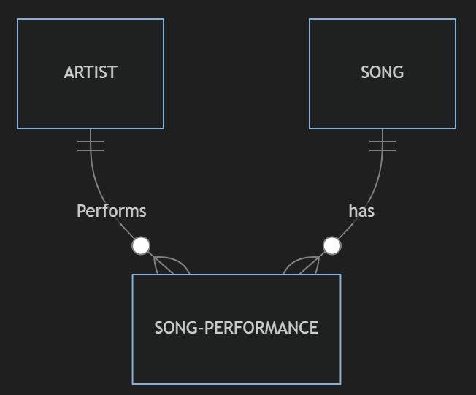
Entity-Relationship (ER) diagrams
Environments
One song can be performed by different artists
We need a “link” table “song-performance”
Keys:
Artist: artist_id (primary key)
Song: song_id (primary key)
Song-performance:
song_performancee_Id (primary key)
artist_id (foreign key)
song_id (foreign key)
artist_id + song_id (unique index)
Notes:
But what if we want to know the different performances the same artist have done of the same song?
Maybe we are modelling a concert booking system?
How would that ER diagram look like?

Slide 11
We are done Keep on learning!

